Slide 1
Lesson objective
PBiS focus
Empathy – allow others to work
Learn – seeking feedback to improve
Title: Unusual data
Aim – be able to:
Describe and identify outliers in a data set
Explain the affect an outlier has on mean and median
Plan:
Daily review: Dot plots, Stem and leaf
Weird numbers
Need calculator and whiteboards

Slide 2
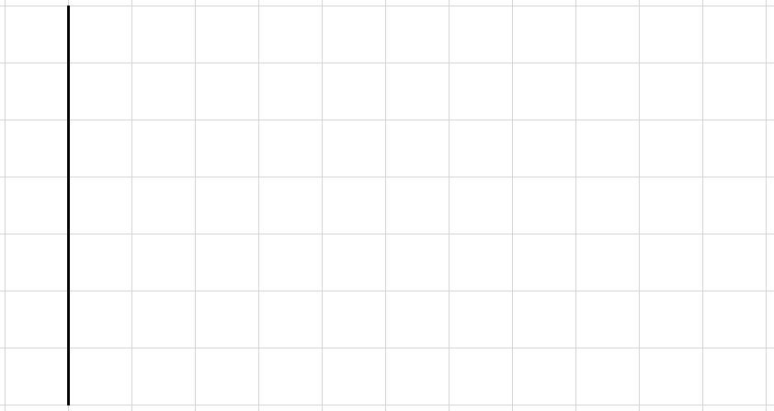
Putting data into a Dot Plot
Whiteboards
Draw scale to fit the highest and lowest numbers
Write the numbers on the lines
Fill in dots on the grid
1, 2, 1, 5, 3, 4, 3, 2, 2, 3, 2, 5, 3, 4, 2, 2, 2, 5, 2, 1, 3, 4, 3, 2, 5, 4, 1, 2, 2, 3
1 2 3 4 5

Slide 3
Putting data into a Dot Plot
Whiteboards
Draw scale to fit the highest and lowest numbers
Write the numbers on the lines
Fill in dots on the grid
4, 7, 5, 5, 6, 4, 7, 8, 2, 5, 6, 6, 5, 5, 7, 5, 7, 5, 3, 6
2 3 4 5 6 7 8

Slide 4
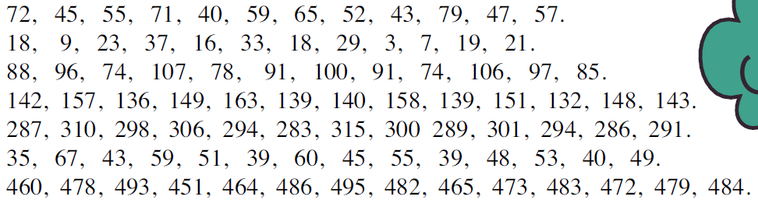

Putting data into a Stem and Leaf Diagram
Whiteboards
Put the data in order
Set up the stem
Fill in the leaves
Write the Key
40, 43, 45, 47, 52, 55, 57, 59, 65, 71, 72, 79
4
5
6
7
0
3
5
7
2
5
7
9
5
Key:
1
2
9
means 52

Slide 5

Putting data into a Stem and Leaf Diagram
Whiteboards
Put the data in order
Set up the stem
Fill in the leaves
Write the Key
3, 7, 9, 16, 18, 18, 19, 21, 23, 29, 33, 37
0
1
2
3
3
7
9
6
8
8
9
1
3
9
Key:
3
7
means 21

Slide 6
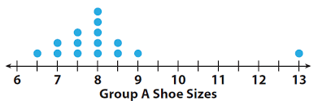
Think, pair and share
What is something you notice about this dot plot that sticks out?

Slide 7
Choral response
An outlier is a data point that lies outside the overall pattern in a distribution.
An outlier is a data point that seems out of place, compared to the whole data.
An outlier is a ________ that seems out of place, compared to the whole data.
An outlier is a ________ that seems __________, compared to the whole data.
An outlier is a ________ that seems __________, compared to the _________.

Slide 8
Outlier: is a data point that lies outside the overall pattern in a distribution.
Pick the outlier from the set:
Set 1: 1, 2, 3, 1, 2, 3, 8, 1, 2, 3, 1, 2, 3
Set 2: 10, 11, 14, 15, 16, 10, 15, 11, 14, 13, 1, 12, 13, 14
Set 3: 4, 31, 32, 34, 38, 45, 56, 48, 52, 29, 101, 41, 37, 35

Slide 9
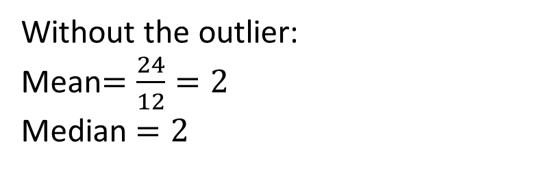
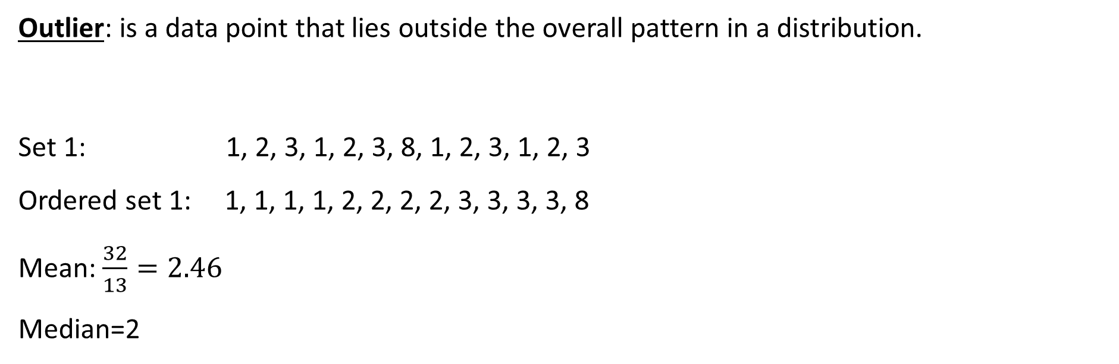
Outlier: is a data point that lies outside the overall pattern in a distribution.
Set 1: 1, 2, 3, 1, 2, 3, 8, 1, 2, 3, 1, 2, 3
Ordered set 1: 1, 1, 1, 1, 2, 2, 2, 2, 3, 3, 3, 3, 8
Mean: $\frac{32}{13}=2.46$
Median=2
Without the outlier:
Mean$=\frac{24}{12}=2$
Median $=2$
Which average is effected more by the outlier?
The Mean
What does the outlier do to the mean compared to the median?
It increases it

Slide 10
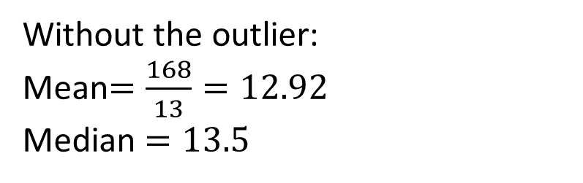
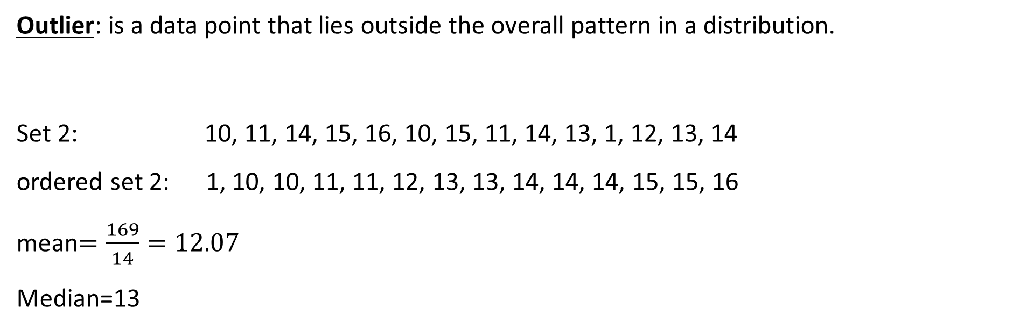
Outlier: is a data point that lies outside the overall pattern in a distribution.
Set 2: 10, 11, 14, 15, 16, 10, 15, 11, 14, 13, 1, 12, 13, 14
ordered set 2: 1, 10, 10, 11, 11, 12, 13, 13, 14, 14, 14, 15, 15, 16
mean$=\frac{169}{14}=12.07$
Median=13
Without the outlier:
Mean$=\frac{168}{13}=12.92$
Median $=13.5$
Which average is effected more by the outlier?
The Mean
What does the outlier do to the mean compared to the median?
It decreases it

Slide 11
Think, pair and share.
What is the outlier?
How do you think it will affect the mean?
With a partner, calculate the mean with AND without the outlier.

Slide 12
Your words
Write in your exercise books:
What is an outlier?
What does an outlier do to the mean?

Slide 13
Reflect
Fist to 5:
Aim – be able to:
Describe and identify outliers from in a data set
Explain the effect an outlier has on mean and median

Slide 14
Individual practice
Read and interpret the data (stem and leaf)
“How does a vampire begin its letters?”
CF

